Slide 1


Modelling the role of anti-vaccination sentiment in disease outbreaks
Levin Wilkinson
Supervised by Dr. Ewan Colman and Professor Rowland Kao

Slide 2





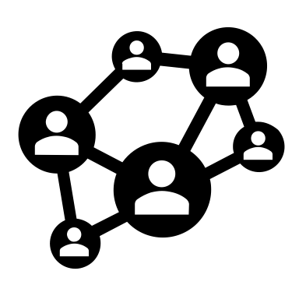


Project overview
Aim:
Investigate how anti-vaccination sentiment affects the spread of disease during an outbreak
Method:
Simulated a disease outbreak on a network with custom heterogeneous shape based on age-based contact patterns in the UK population
Added a behavioural system: each person holds an “opinion” on vaccination and can accept or refuse vaccination
Results:
Quantified the extent to which anti-vaxxers can increase outbreak sizes and the probability of endemic disease

Slide 3
Network basics
Network: a collection of nodes, joined by edges
Node: a single point on a network (represents one person)
Link or edge: a connection between two nodes, along which transmission can occur
Transmission (event): the spread of a property from one node to another along an edge

Slide 4
Network basics
Network: a collection of nodes, joined by edges
Node: a single point on a network (represents one person)
Link or edge: a connection between two nodes, along which transmission can occur
Transmission (event): the spread of a property from one node to another along an edge

Slide 5
Network basics
Network: a collection of nodes, joined by edges
Node: a single point on a network (represents one person)
Link or edge: a connection between two nodes, along which transmission can occur
Transmission (event): the spread of a property from one node to another along an edge

Slide 6
Network basics
Network: a collection of nodes, joined by edges
Node: a single point on a network (represents one person)
Link or edge: a connection between two nodes, along which transmission can occur
Transmission (event): the spread of a property from one node to another along an edge

Slide 7








How do we model epidemics?
At work
At school
Shopping
At home
Exercise and
activities
…too many types of interaction to model in fine detail!
Public venues
Extended family

Slide 8

How do we model epidemics?
At work
At school
Shopping
At home
Exercise and
activities
…too many types of interaction to model in fine detail!
Public venues
Extended family

Slide 9

How do we model epidemics?
At work
At school
Shopping
At home
Exercise and
activities
…too many types of interaction to model in fine detail!
Public venues
Extended family

Slide 10
How do we model epidemics?
Age is a key factor in network structure
At work
At school
Shopping
At home
Exercise and
activities
…too many types of interaction to model in fine detail!
Public venues
Extended family

Slide 11
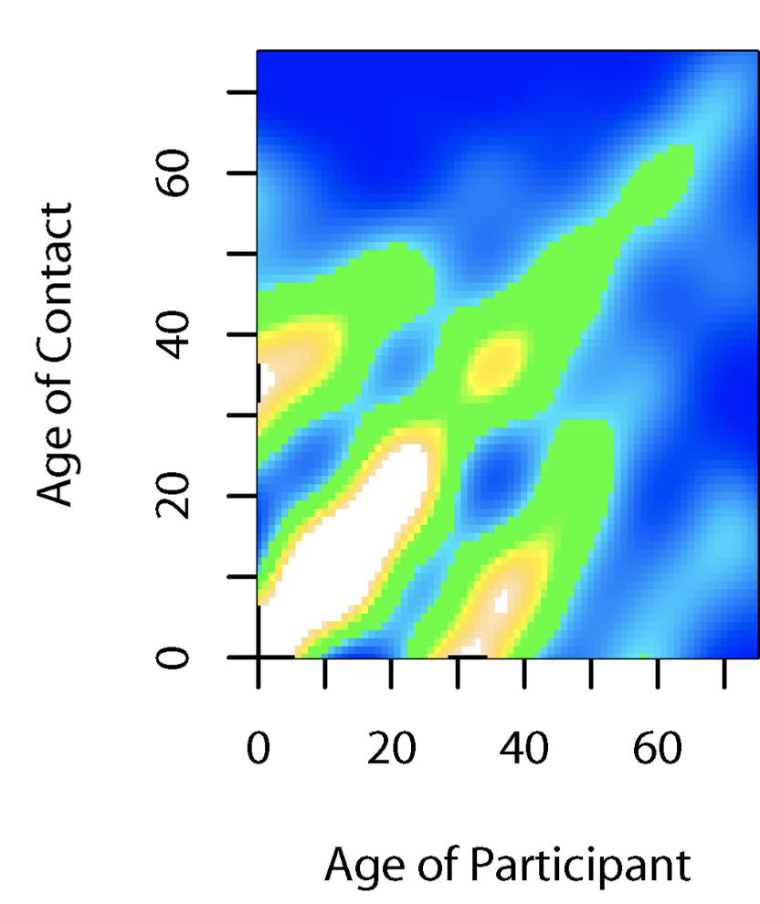
Background: networks
POLYMOD study tells us how often age groups interact on an average day [1]
Recorded both physical and non-physical contacts so is useful for disease and behaviour modelling
Corroborated by more recent work conducted in 2019 [2]
How does this become a network shape?
Contact surface for physical contacts of UK participants in the POLYMOD study [1]
[1] J. Mossong et al. (2008). Social contacts and mixing patterns relevant to the spread of infectious diseases. PLoS Medicine, 5(3), p.e74. [2] P. Klepac et al. (2020) Contacts in context: large-scale setting-specific social mixing matrices from the BBC Pandemic project. medRxiv pre-print.

Slide 12
Background: networks
Relatively simple network shapes can create realistic dynamics
A popular shape is the small world network, which is found in real-life social networks [3, 4]
Small world links add dimensionality and add realistic complexity [4]
More links can be added to nodes to represent people with more contacts
A Newman-Watts network [5] with ring links (dark blue) and small world links (light blue)
[3] Milgram, S. (1967). The small world problem. Psychology today, 2(1), 60-67. [4] J. Travers and S. Milgram (1977). An experimental study of the small world problem. In Social Networks (p.179-197). Academic Press. [5] M. E. Newman (2000). Models of the small world. Journal of Statistical Physics, 101(3), 819-841.

Slide 13
Method: networks

Slide 14
Method: networks
Children (19%)
Elderly (18.5%)
Adults (62.5%)

Slide 15
Method: networks
Children (19%)
Elderly (18.5%)
Adults (62.5%)

Slide 16
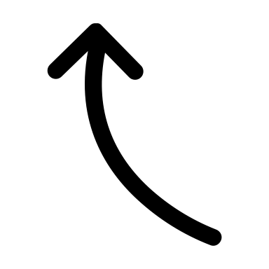
Method: networks
Children (19%)
Elderly (18.5%)
Adults (62.5%)
British elderly people average less than 2 physical daily elderly contacts each!

Slide 17
Method: networks
Children (19%)
Elderly (18.5%)
Adults (62.5%)
British elderly people average less than 2 physical daily elderly contacts each!

Slide 18
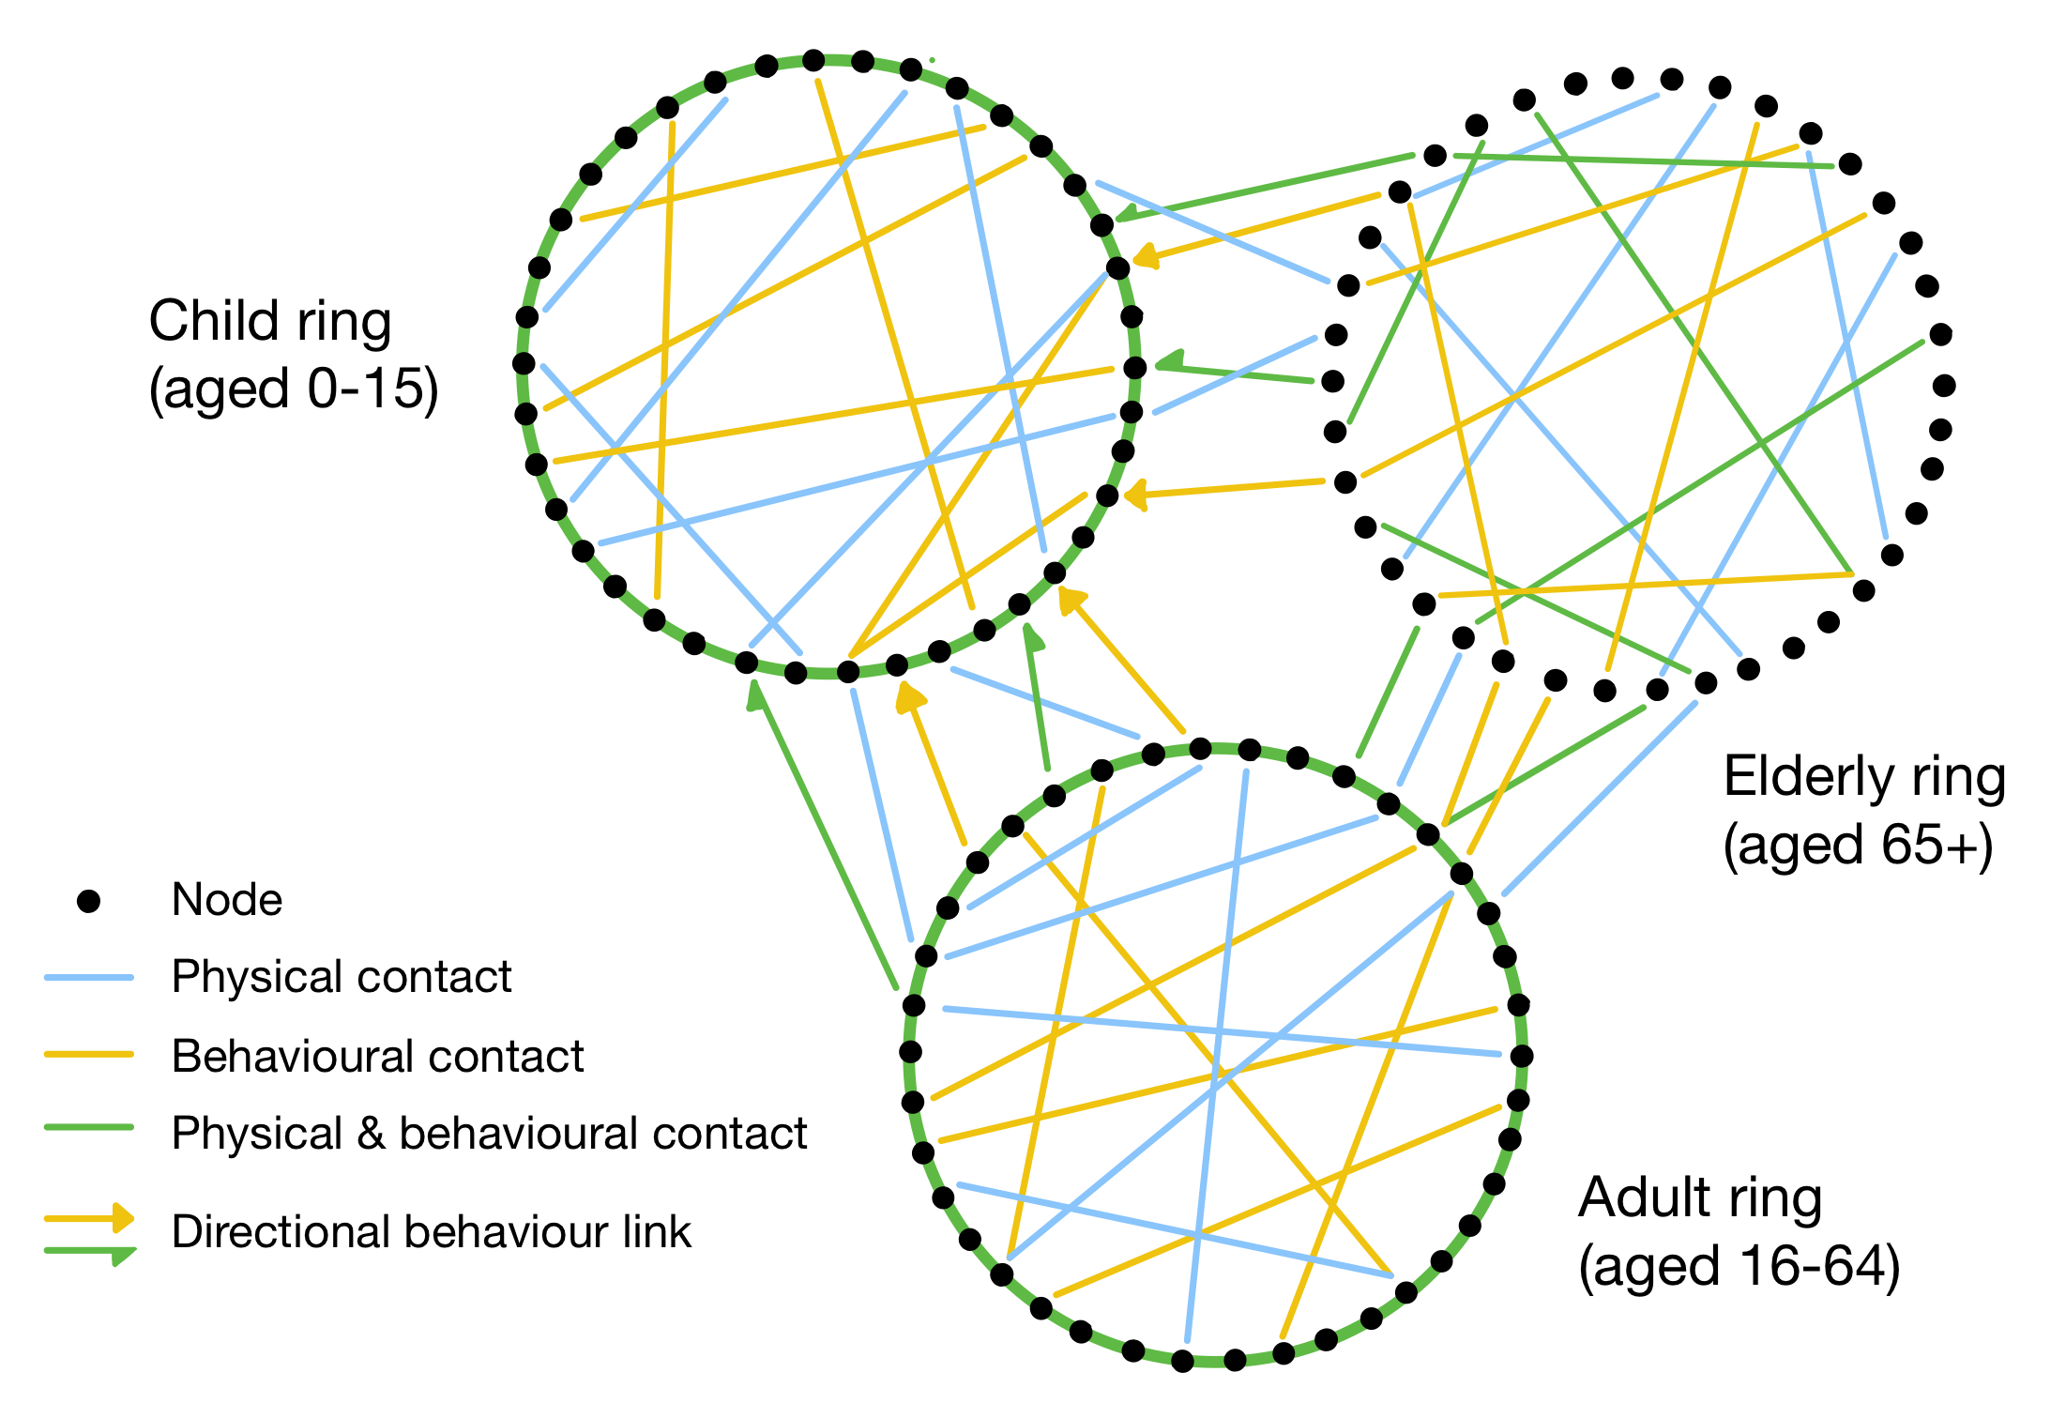
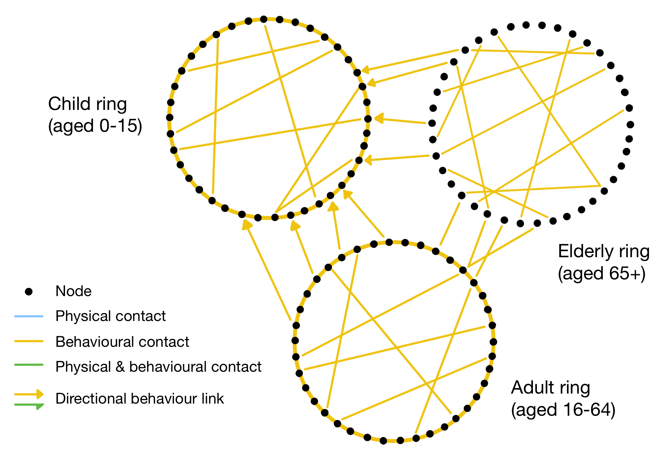
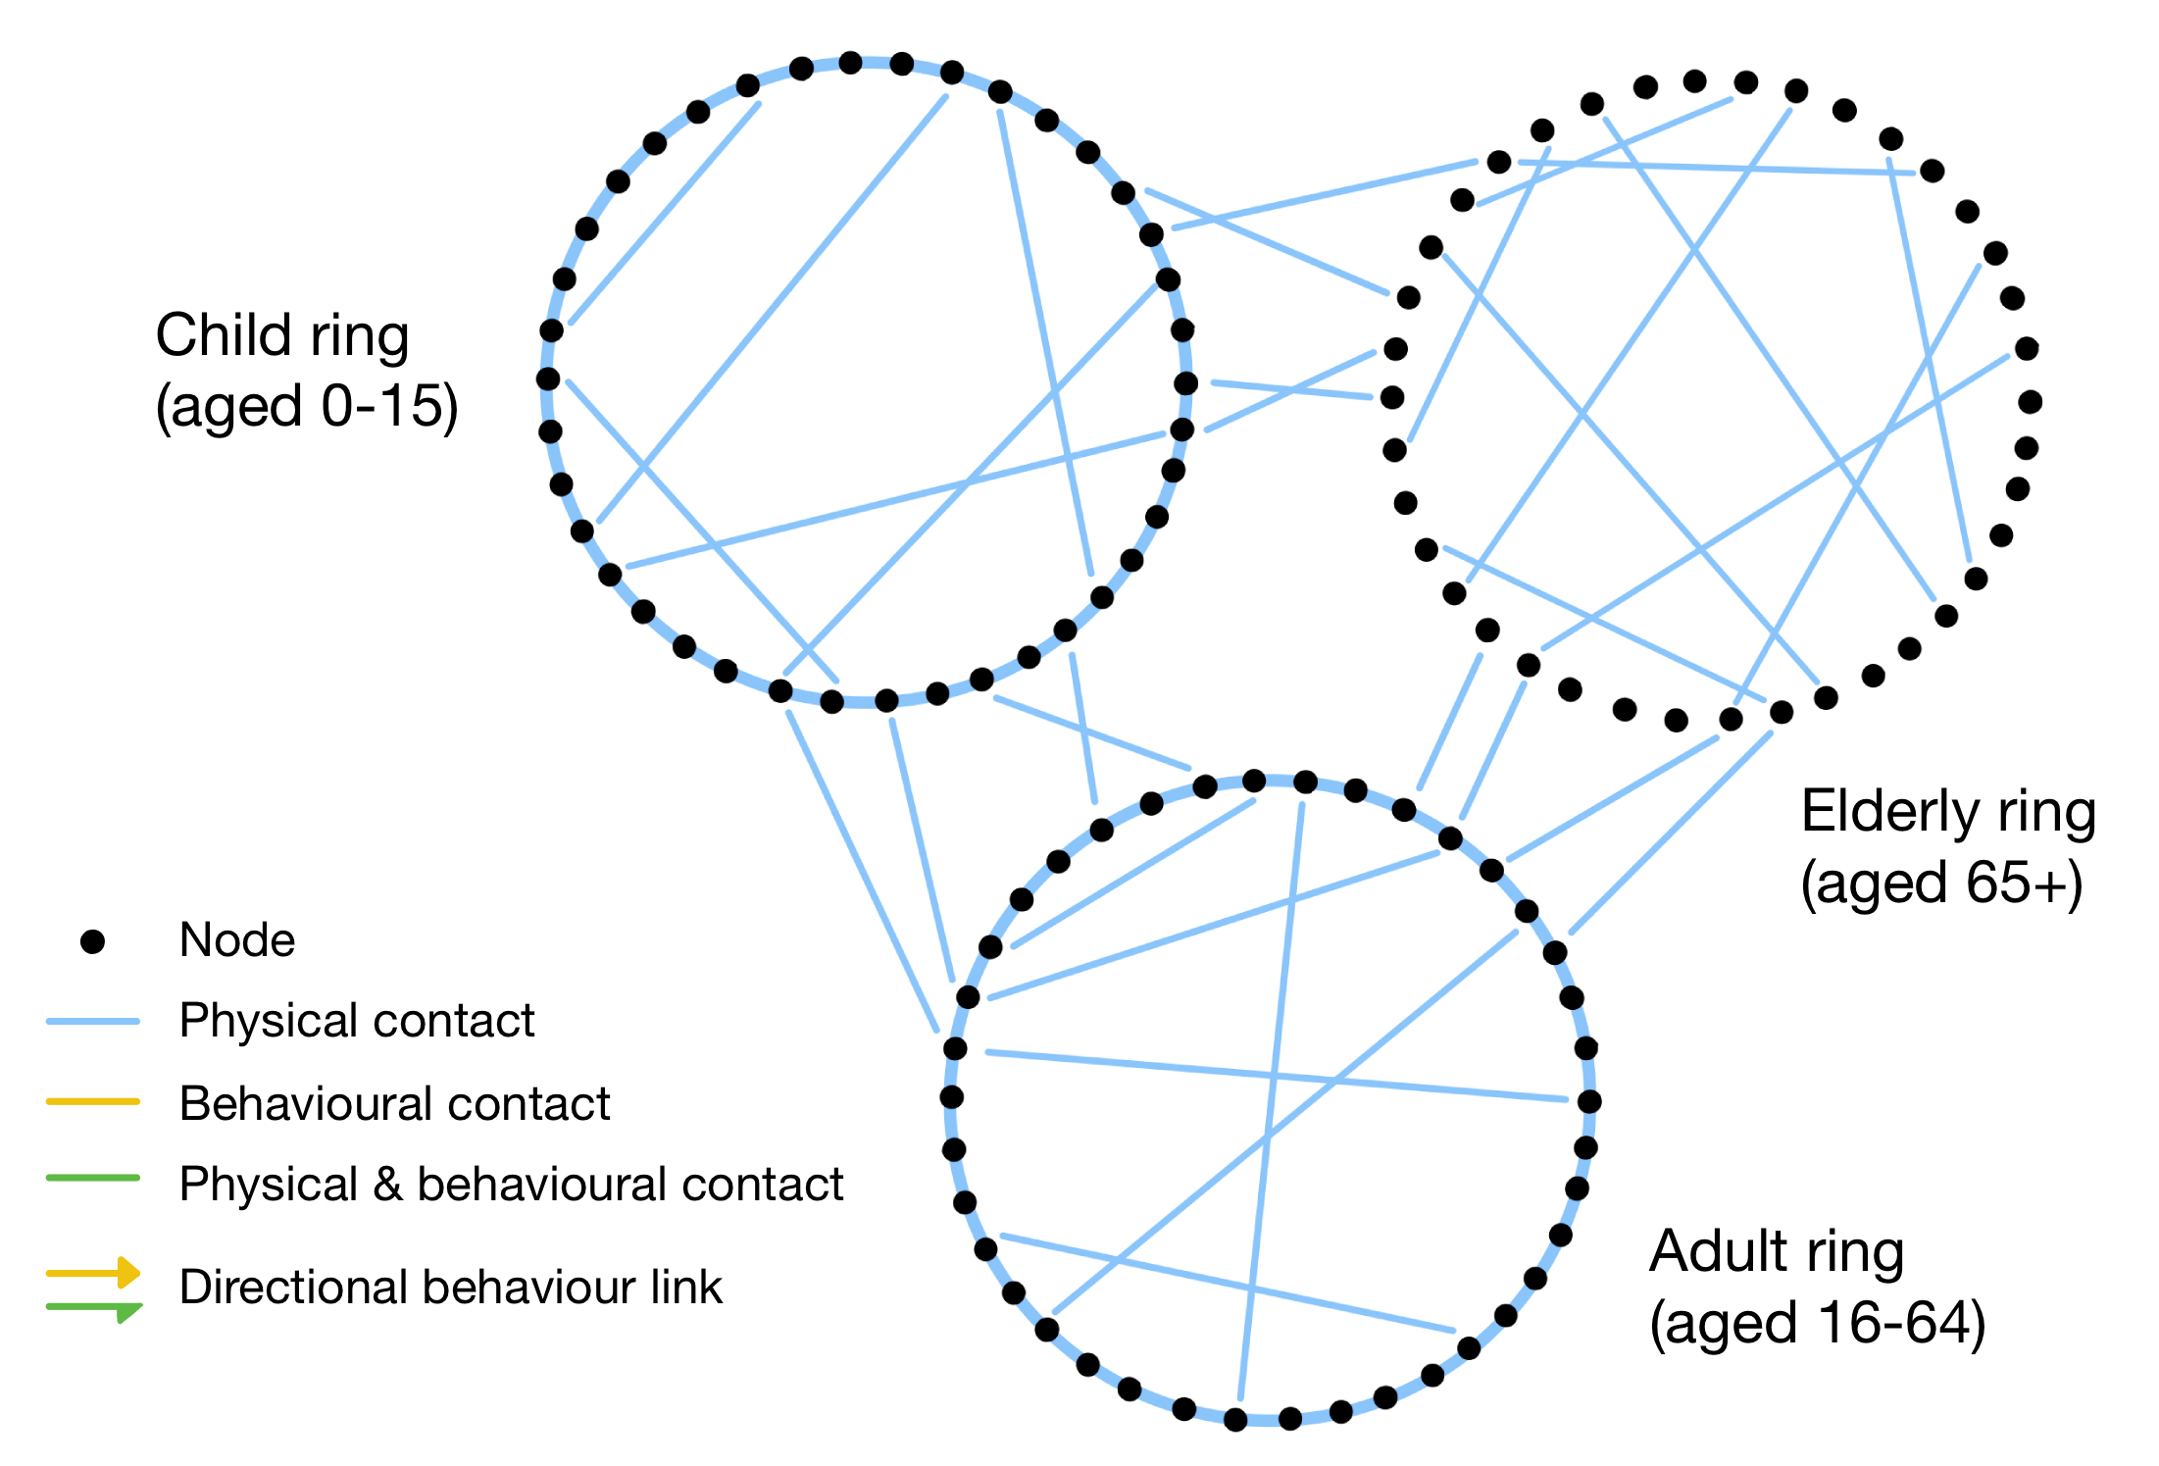
Method: networks
Another feature is directionality of behavioural links: children cannot influence adults/elderly
Network shape is directly informed by population data – more useful than a generic small-world shape
How do we model disease on this network?

Slide 19
Background: disease modelling
Compartmental models are overwhelmingly popular in disease modelling [6]
The most common disease model is the SIR(S) model [7]:
Susceptible to infection
Infected by a neighbour who was in the infected state
Recovered from disease and temporarily immune
(Susceptible again once immunity wears off.)
Many variations of this such as SIRV (vaccination), SEIR (exposure)
[6] L. J. Allen et al. (2008). Mathematical Epidemiology (Vol. 1945). Berlin: Springer. [7] Beckley, R. et al. (2013). Modeling epidemics with differential equations. Tennessee State University Internal Report.

Slide 20
Method: disease modelling
My simulation uses a SIRVS model (includes vaccination)
Vaccination is offered to every node at a random point in the first year, then repeated at yearly intervals
If a node is in the anti-vaccination state when offered the vaccine, it will refuse
How do we model opinion spread?
Susceptible
Infected
Recovered
Vaccinated
Schematic of the SIRVS model in the simulation

Slide 21
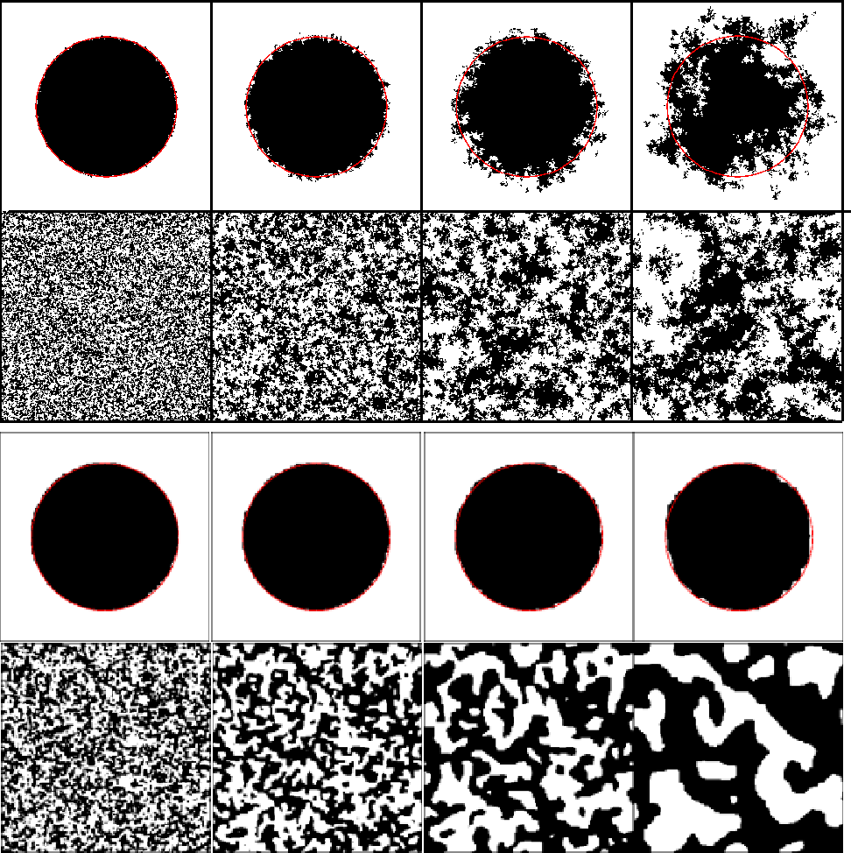
Background: behaviour modelling
The voter model is a common two-state model of opinion transmission [8]:
A random node is picked at a random time
A random neighbour of the node is picked
The node inherits the opinion of its neighbour
Over time this produces domains like the Ising model, but with more diffuse boundaries [9]
Effects of voter model (top) and Ising model (below) on systematic and random distributions on a 2D lattice [9]
[8] A. Sîrbu et al. (2017). Opinion dynamics: models, extensions and external effects. Participatory sensing, opinions and collective awareness, Springer Cham, 363-401. [9] I. Dornic et al. (2001). Critical Coarsening without Surface Tension: the Universality Class of the Voter Model. Phys. Rev. Lett., 87(4), 045701.

Slide 22
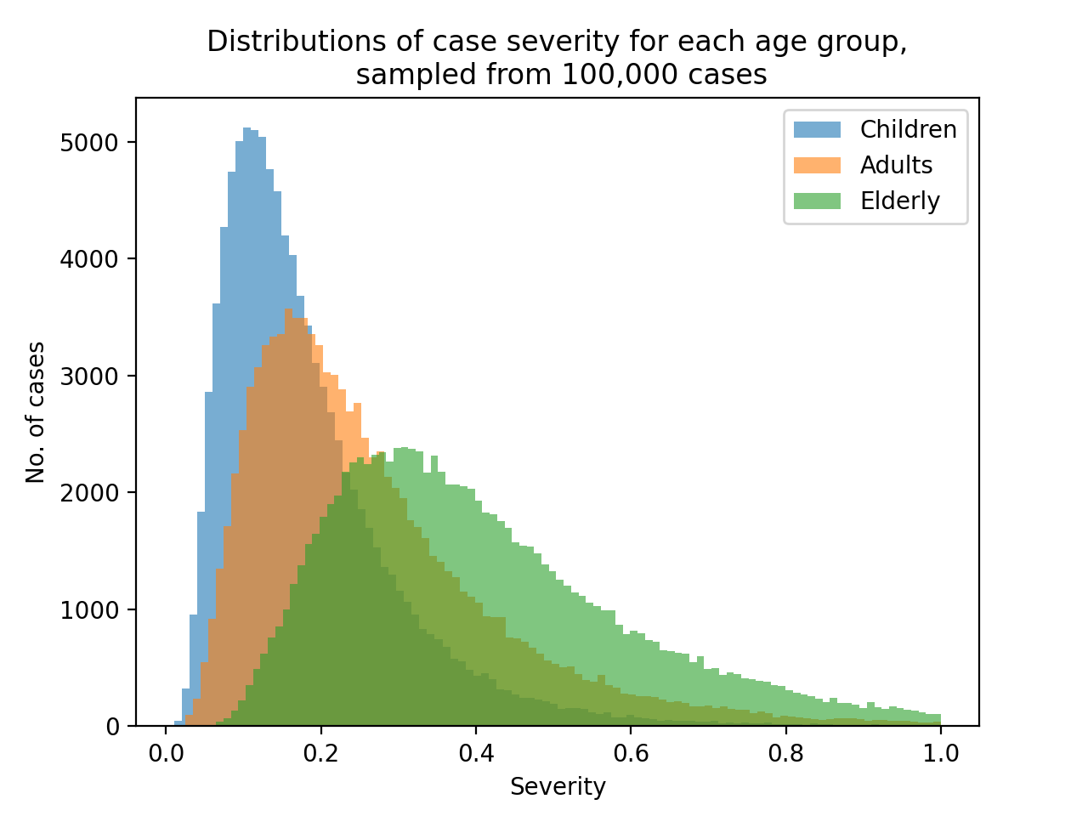
Method: behaviour modelling
My model uses a custom biased voter model
Opinions are influenced by perceived risk of disease
Each case of disease has a severity, influenced by the age group of the affected node
Having a severe case (>0.8) or having a behavioural neighbour with one decreases probability of inheriting anti-vaccination opinion
Disease severity distributions for the three simulated age groups (children, adults and elderly)

Slide 23
Limitations of the model
Capabilities:
Includes age-specific features such as contact density, case severity and directional influence
Flexible for different respiratory diseases, such as COVID-19 or flu

Slide 24
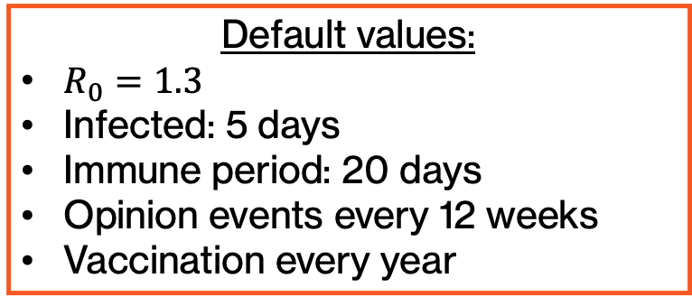
Limitations of the model
Capabilities:
Includes age-specific features such as contact density, case severity and directional influence
Flexible for different respiratory diseases, such as COVID-19 or flu

Slide 25
Limitations of the model
Capabilities:
Includes age-specific features such as contact density, case severity and directional influence
Flexible for different respiratory diseases, such as COVID-19 or flu
Limitations:
Static network: same contacts throughout
No temporal changes to contact density: does not consider weekends or nights
Vaccination is 100% effective
Infected nodes can be vaccinated
Random vaccination scheme
Simplistic behaviour model
…and more!

Slide 26
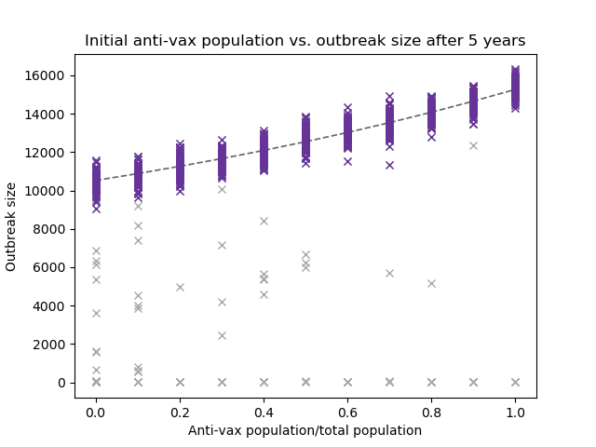
Results
How does anti-vax population affect the number of cases in an outbreak?
Graph showing the number of cases in outbreaks with different amounts of anti-vaxxers present, over five years (endemic outbreaks plotted in purple)

Slide 27
Results
How does anti-vax population affect the number of cases in an outbreak?
Endemic: disease is present in the system in the long-term (such as flu)
Graph showing the number of cases in outbreaks with different amounts of anti-vaxxers present, over five years (endemic outbreaks plotted in purple)

Slide 28
Results
How does anti-vax population affect the number of cases in an outbreak?
Endemic: disease is present in the system in the long-term (such as flu)
For sustained outbreaks, increasing the anti-vax population increases the number of cases in an outbreak
A larger anti-vax population also increases the likelihood that disease will become endemic
Graph showing the number of cases in outbreaks with different amounts of anti-vaxxers present, over five years (endemic outbreaks plotted in purple)

Slide 29
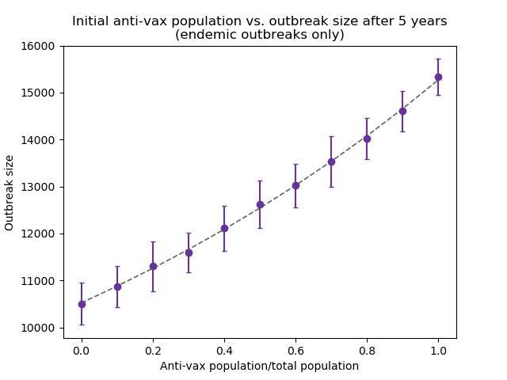
Results
How does anti-vax population affect the number of cases in an endemic outbreak?
The number of cases follows an exponential trend with the anti-vax population size
Therefore, it is vital to keep the average anti-vax population low to protect against the knock-on effect of any surges in anti-vaccination sentiment
Graph showing the exponential trend in the number of cases as a function of anti-vax proportion

Slide 30
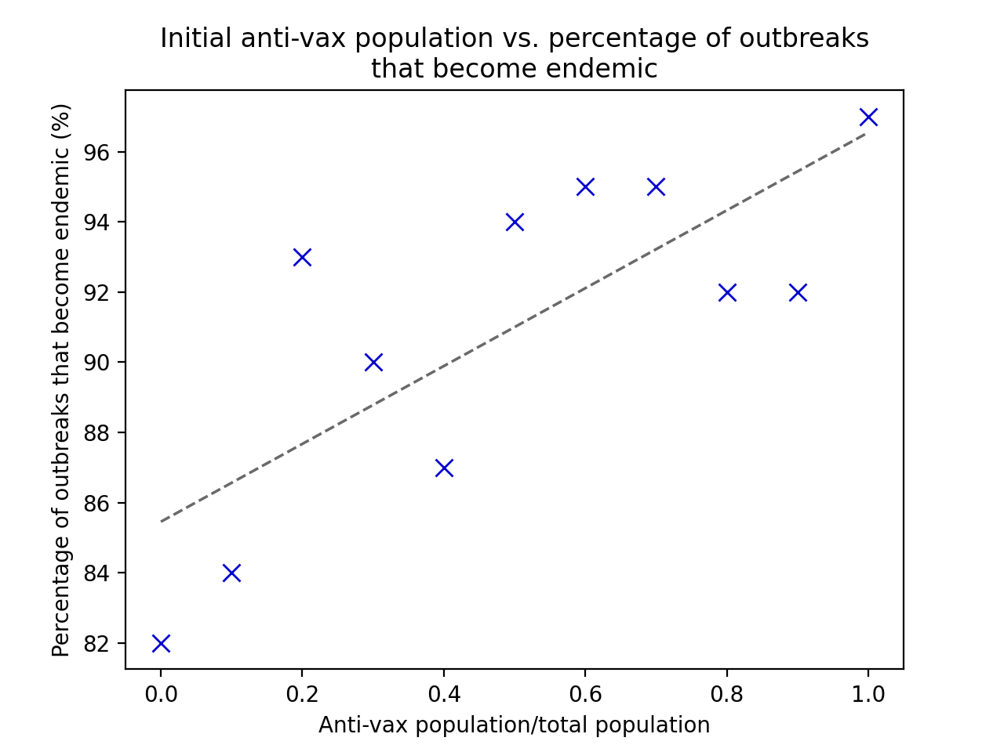

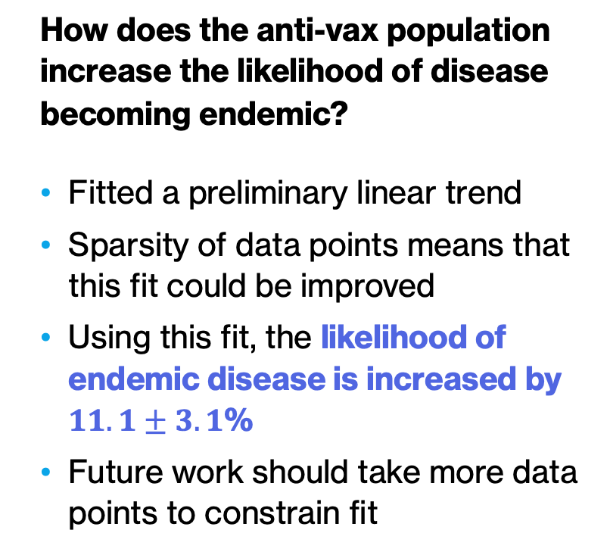
Results
Graph showing the increase in the likelihood of endemic disease for larger anti-vax populations

Slide 31
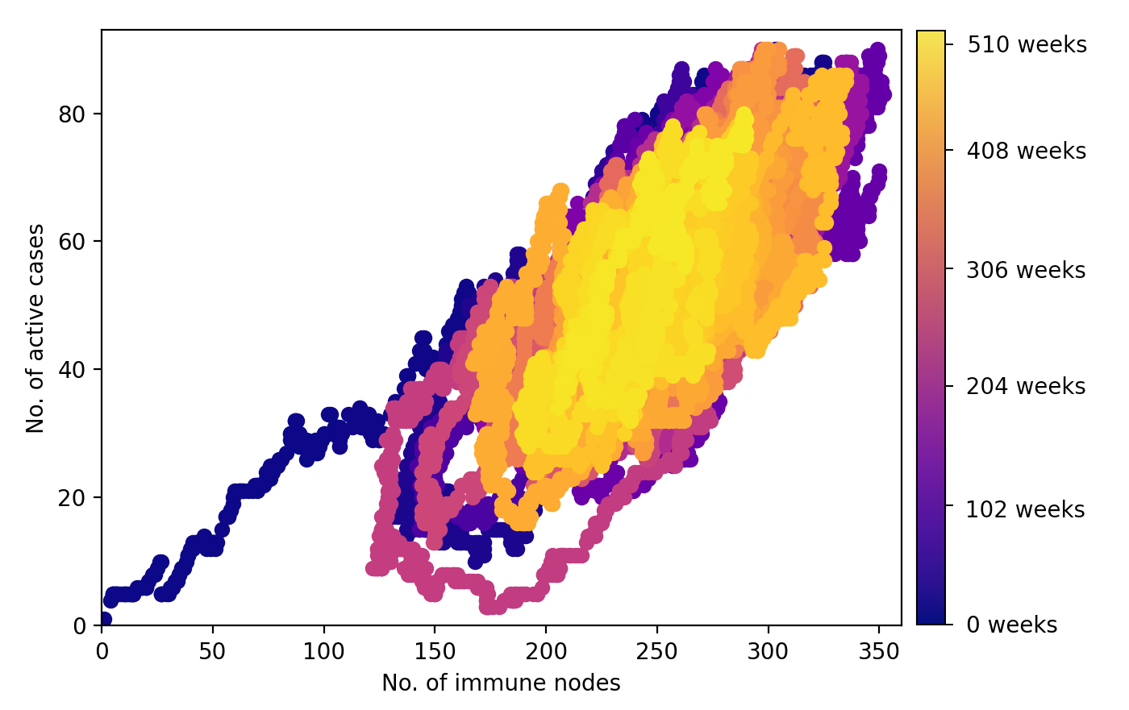
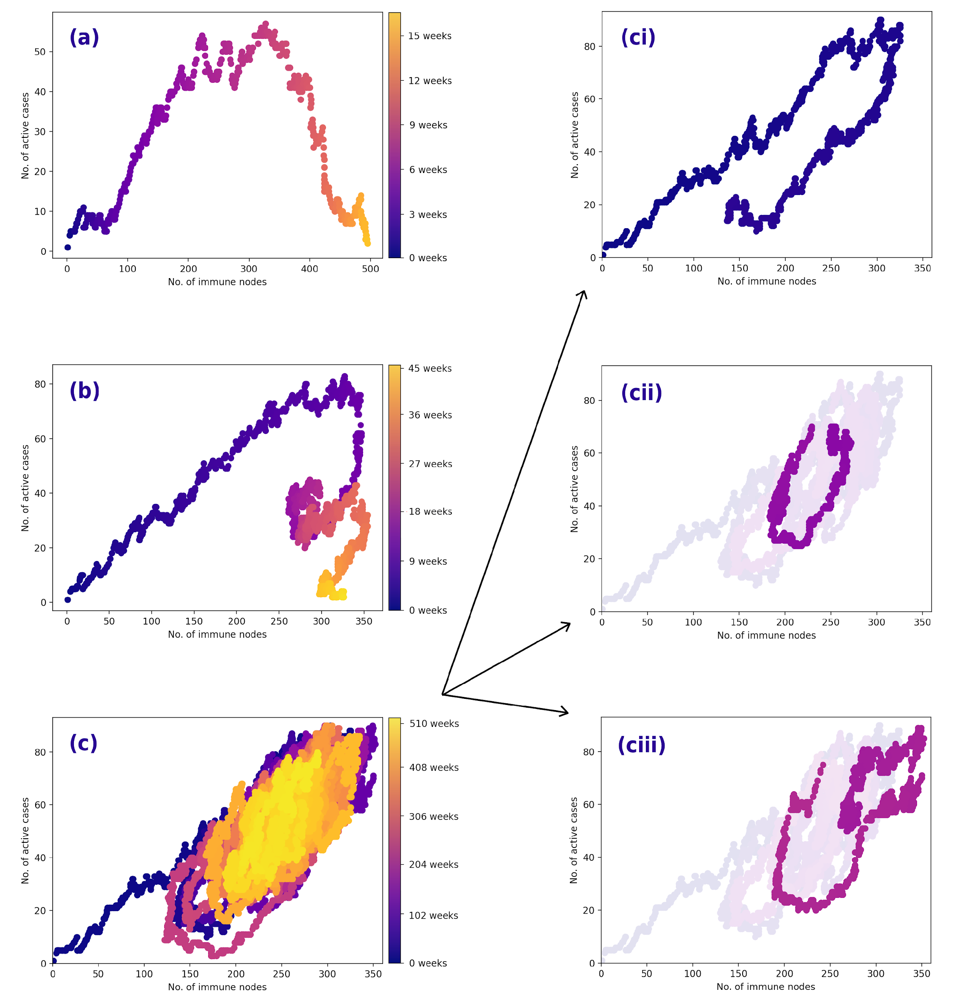
Results
Is the model consistent with previous studies?
Papst et al. mathematically modelled vaccine uptake and predicted “cycles” of high vaccination levels and high active cases
This model produces similar cyclic results, with additional complex features due to the random nature of the network model
Top: immune nodes vs. active cases for first 10 years of an endemic outbreak. Bottom left: an observed “cycle”. Bottom right: complex behaviour due to randomness
[10] I. Papst et al. (2021). Modeling the interplay between seasonal flu outcomes and individual vaccination decisions. arXiv preprint 2101.07926.

Slide 32
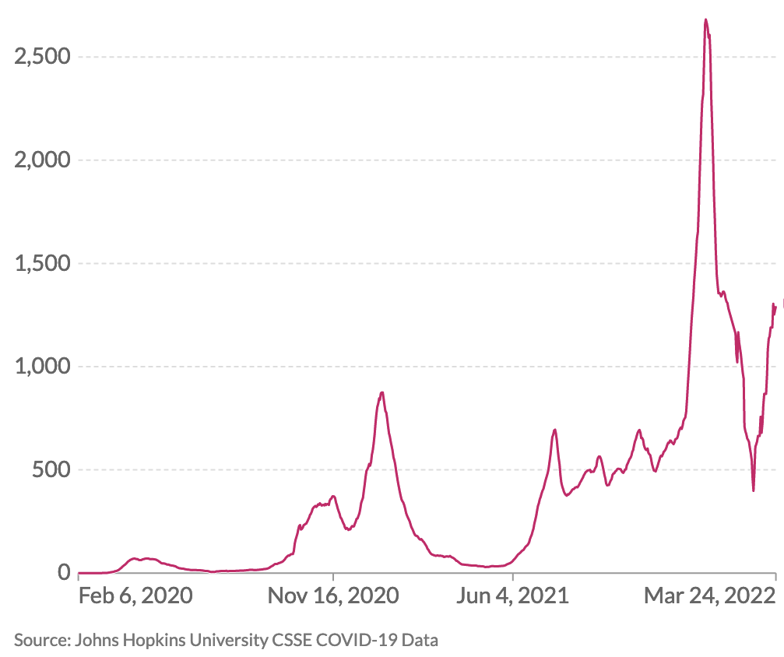
Scope for future work
Further sophistication of model
Making the network dynamic: remove and add nodes and edges over time, change the position and amount of links
Allow multiple variants running in parallel, perhaps with different vaccination resistance levels
Apply model to the study of real diseases such as COVID-19 and flu
Daily confirmed COVID-19 cases in the UK since February 2020 (7 day rolling avg.) [11]
[10] I. Papst et al. (2021). Modeling the interplay between seasonal flu outcomes and individual vaccination decisions. arXiv preprint 2101.07926. [11] Our World in Data (2022). COVID-19 Data Explorer. Retrieved 24/03/22.

Slide 33



Conclusion
Created a custom age-based heterogeneous network and incorporated custom disease and behaviour models
Produced reasonable results for the effects of anti-vaccination populations on outbreaks
Lots of future scope for the expansion and application of this model
!
?
…
…
!

Slide 34
Thank you for listening!
I will now take any questions.

Slide 35
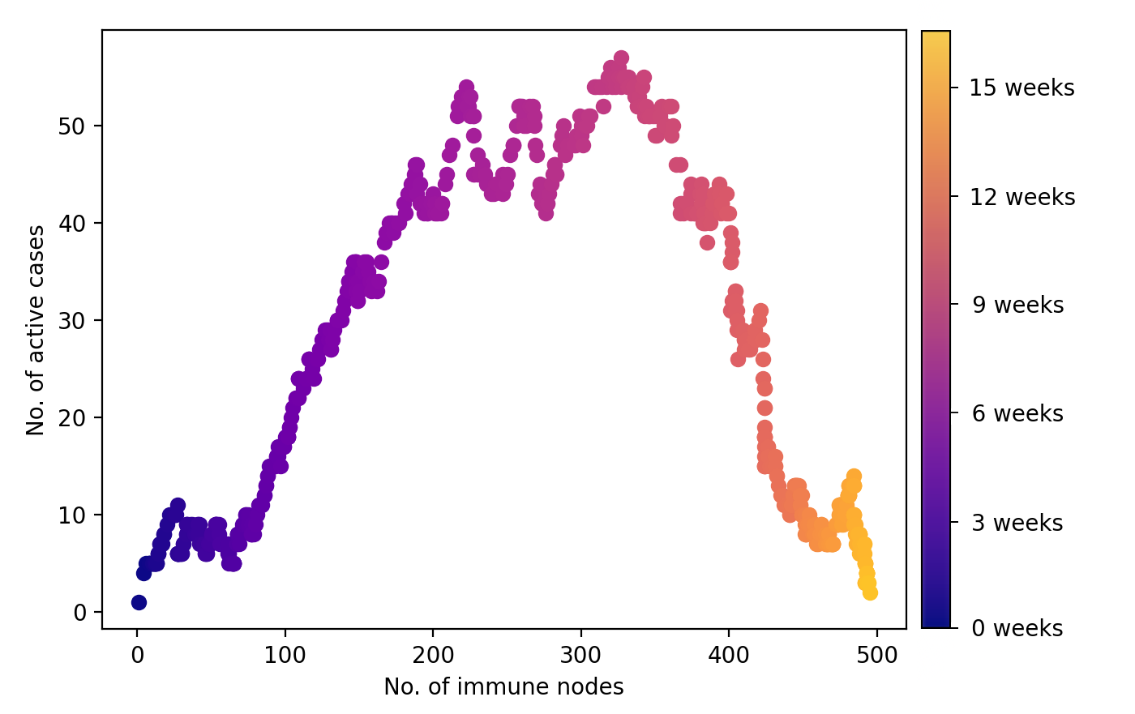
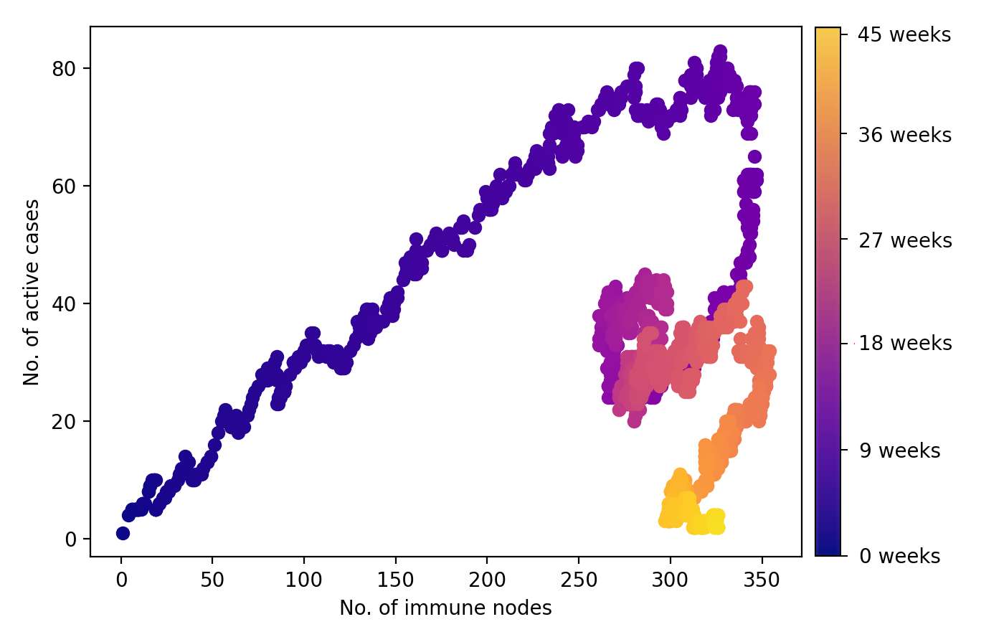
Supplement: Papst et al. cycles
No. of active cases vs. no. of immune nodes for an outbreak with immunity time period of 90 days for both post-case and vaccination
No. of active cases vs. no. of immune nodes for an outbreak with 20 days post-case immunity, 90 days post-vaccination immunity
[10] I. Papst et al. (2021). Modeling the interplay between seasonal flu outcomes and individual vaccination decisions. arXiv preprint 2101.07926.

Slide 36
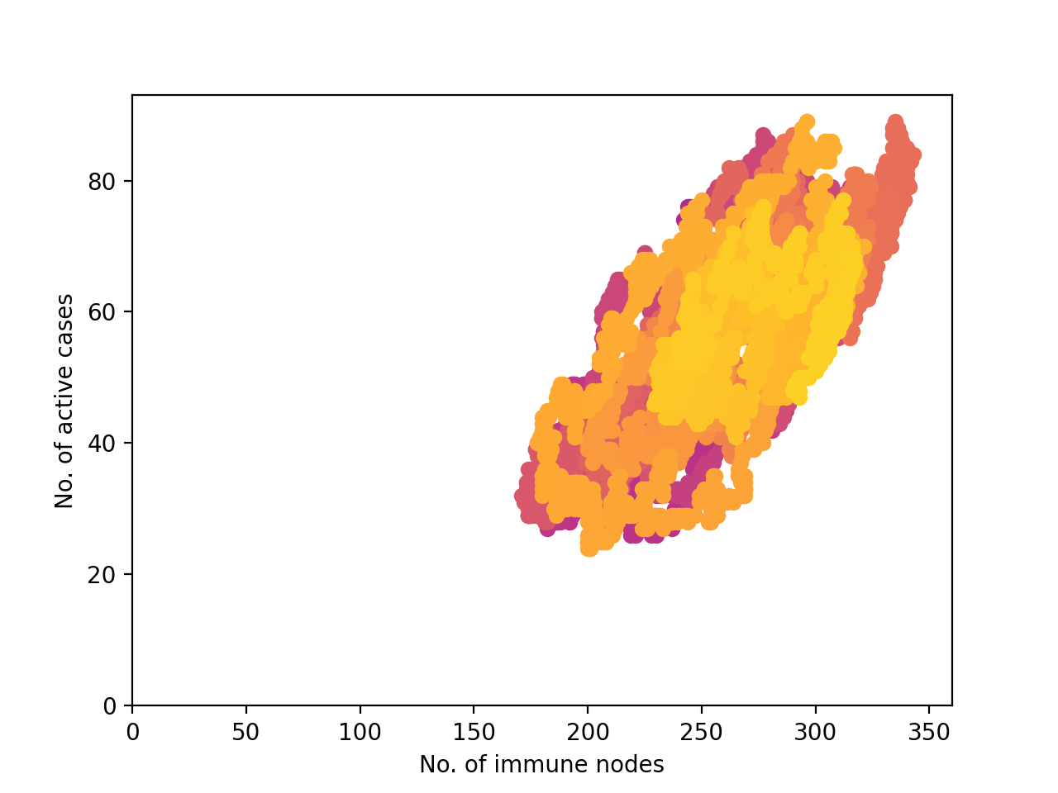
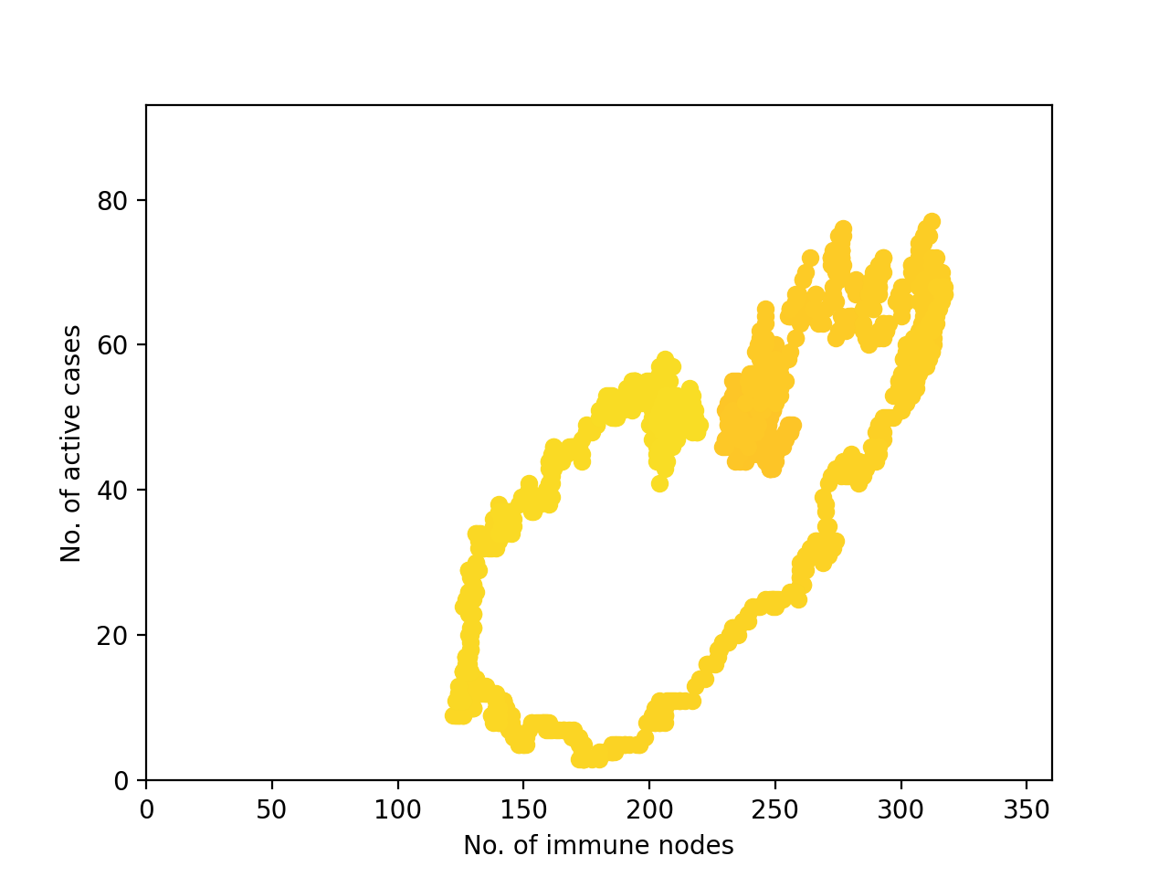
Supplement: Papst et al. cycles
Second cycle: consistent periodic cycling with decreasing radius (day 790-1741)
Second cycle: second example of “blowout” leading to a larger loop(day 1680-1812)
[10] I. Papst et al. (2021). Modeling the interplay between seasonal flu outcomes and individual vaccination decisions. arXiv preprint 2101.07926.

Slide 37
Supplement: biased voter model
Behavioural contact only
Physical contact only
Physical and behavioural contact
Anti
S=0.18
Pro
S=0.82
Pro
S=0.24
Pro
S=0.35
Anti
S=0.47

Slide 38
Supplement: biased voter model
Behavioural contact only
Physical contact only
Physical and behavioural contact
Anti
S=0.18
Pro
S=0.82
Pro
S=0.24
Pro
S=0.35
Anti
S=0.47

Slide 39
Supplement: biased voter model
Behavioural contact only
Physical contact only
Physical and behavioural contact
Anti
S=0.18
Pro
S=0.82
Pro
S=0.24
Pro
S=0.35
Anti
S=0.47

Slide 40
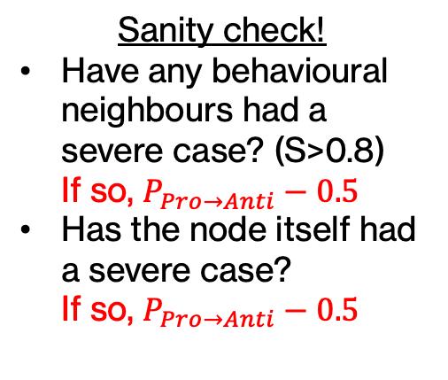
Supplement: biased voter model
Behavioural contact only
Physical contact only
Physical and behavioural contact
Anti
S=0.18
Pro
S=0.82
Pro
S=0.24
Pro
S=0.35
Anti
S=0.47

